Slide 1
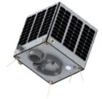
Learning Objectives
To identify key elements within Kerbal
To launch a rocket
To test different components
Open Systems and Advanced Manufacturing Technologies

Slide 2
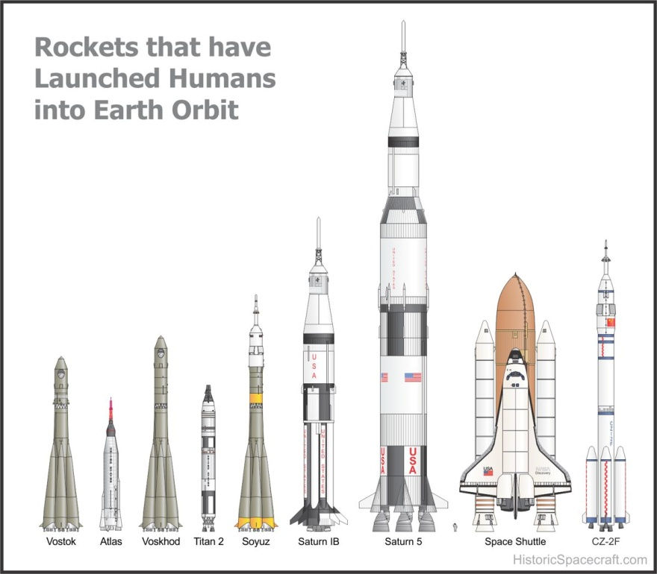
What do you need to launch a rocket?
Nose – the top cone of a rocket?
Where will the pilot sit?
Do you need fins?
Where will the fuel go?
Parachute?

Slide 3
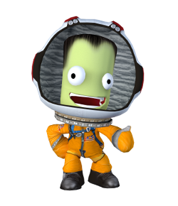
KERBAL software
Kerbal is a piece of software where you can:
build a rocket using different parts
launch a rocket into space
achieve orbit
visit planets
control a rocket in space and take off/land
complete missions

Slide 4
Lets Launch a Rocket!

Slide 5
KERBAL software
Open up Kerbal and select sandbox add a save name

Slide 6
KERBAL software
This is the main area where you can hover over areas to enter buildings etc. The tallest building is the VAB – Vehicle Assembly Building and this is the main area you will be in – building a rocket.

Slide 7
KERBAL software
When you click on the VAB you enter the building and see the below. On the left is a toolbar with all the parts and when you click on one of the toolbar tabs you then see all the parts available in that section.

Slide 8
TASK 1
You all have a worksheet showing the toolbar – open up Kerbal, sandbox and enter the VAB. Label the toolbar worksheet by hovering over the toolbar tabs to find out what it is called.

Slide 9
TASK 2
Follow the instructions on the handout and create the rocket as seen below – launch the rocket and lets achieve orbit!

Slide 10
Plenary
What went well?
What happened on re-entry?

