Slide 1
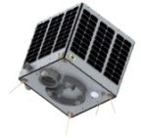
Learning Objectives
Be able to use simulation software and applications effectively
To develop a rocket and test the outcome of any changes
Open Systems and Advanced Manufacturing Technologies

Slide 2
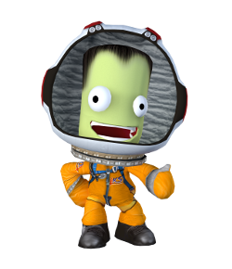
What would happen if ……
Think about one of your rocket launches from previous lessons
What if you changed a part – what affect would that have?

Slide 3
COURSEWORK TASK
You need to choose one of your rockets from previous lessons – can be the one we achieved orbit with on the first lesson on Kerbal
You then need to change elements – for example change a part – make a note of the change and then what happened following the change
Complete coursework booklet section 5

