Slide 1
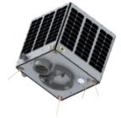
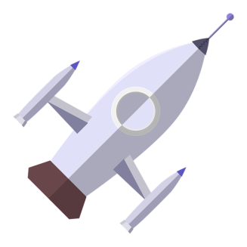
Learning Objectives
To identify the force used
To describe how the force can be adjusted
To create a rocket and launch mouse
Open Systems and Advanced Manufacturing Technologies

Slide 2
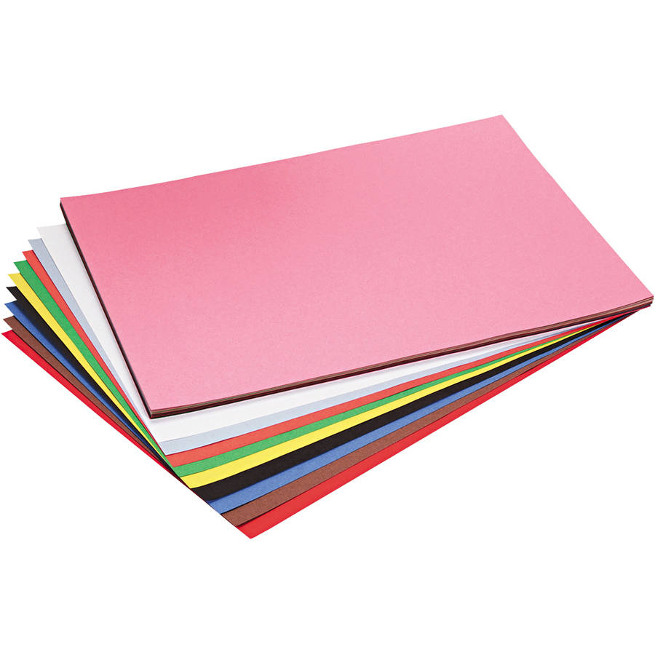
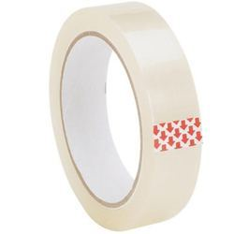
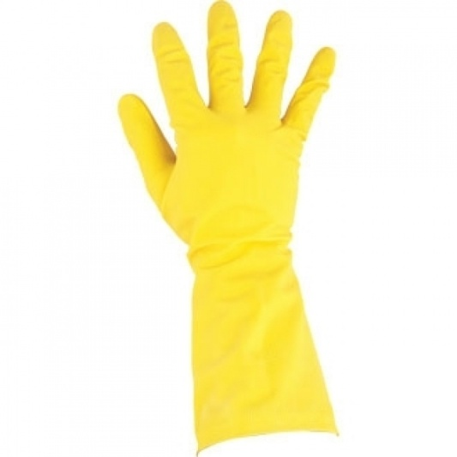
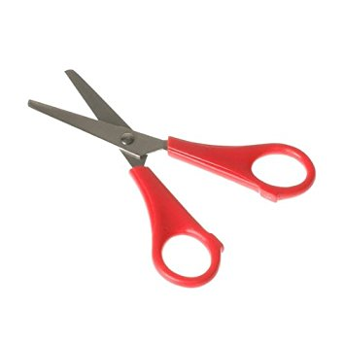
Starter
What do you think we can do with this?

Slide 3
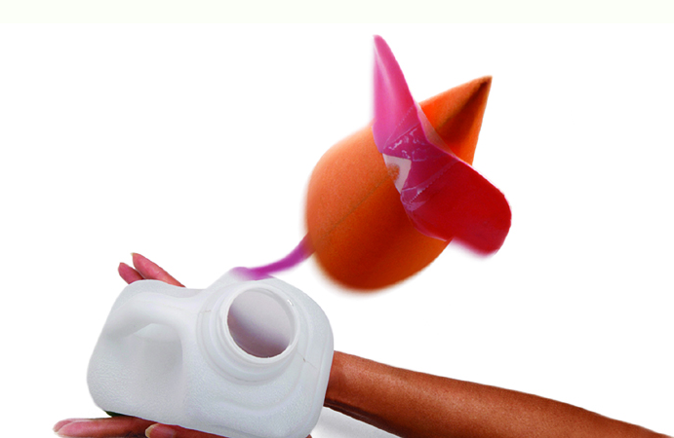
Rocket Mice
We are going to create rocket mice

Slide 4
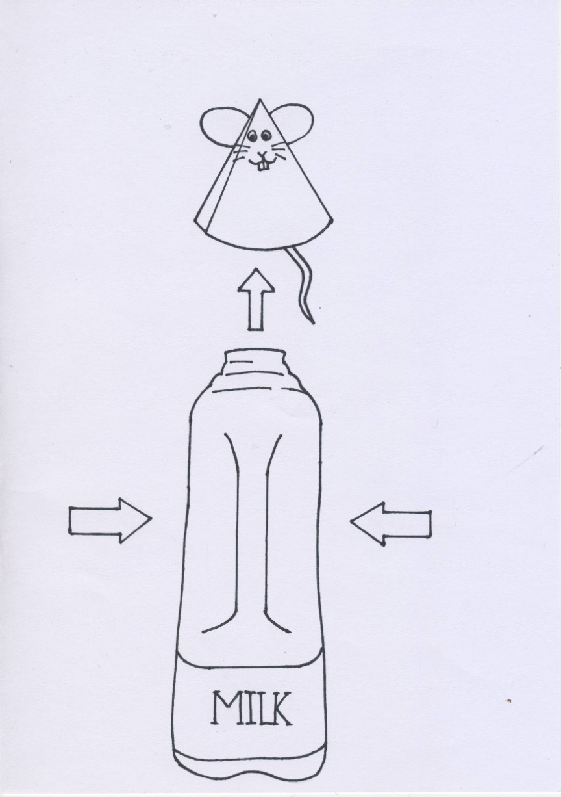
What forces are used?
THRUST?
WEIGHT?
LIFT?
DRAG?

Slide 5
What forces are used?
THRUST
You will create the thrust by squashing the milk carton to release the air up through the top and launch the mouse

Slide 6
What forces are used?
WEIGHT
The weight of the paper used will affect the height as well as any decorations
Can you test this?

Slide 7
What forces are used?
LIFT
The mouse is launched up into the air
How will you measure the height?

Slide 8
What forces are used?
DRAG
As the rocket is launched the air resistance will drag the rocket back down so the thrust has to be powerful enough to launch through this

Slide 9
Your Turn
Look at the handout and create your own mouse – remember to make it clear it is yours
Test your mouse a few times to see what works
Predict how high you think it will go?
Launch your mouse into (not quite space) but the space above the milk carton !!

Slide 10
Plenary - What heights did you achieve?
Right click on chart and select ‘edit data’ add in each groups top height in cm

