Slide 1
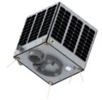
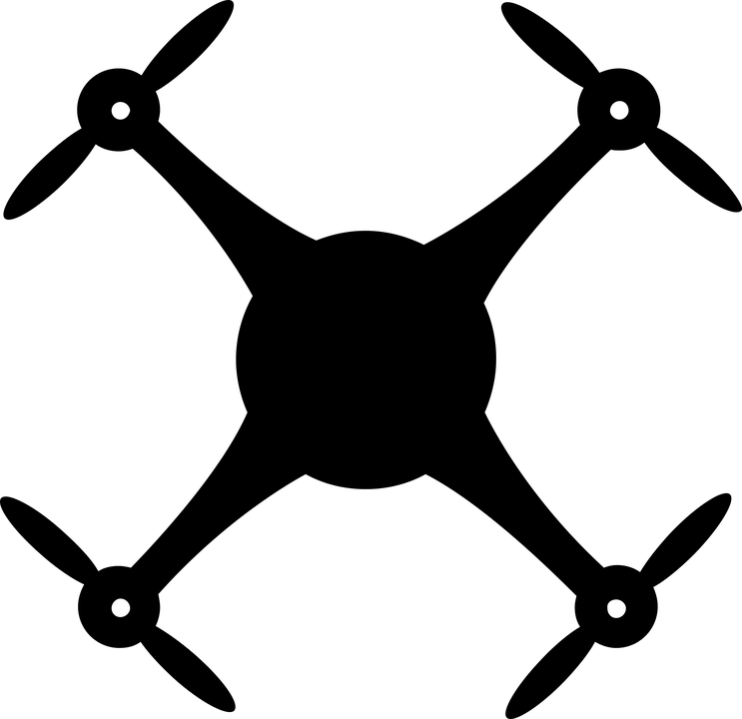
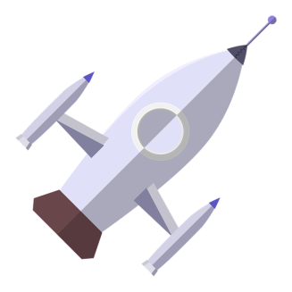
Learning Objectives
To describe the material choices against design
To create a possible rocket design with clear material choices
Open Systems and Advanced Manufacturing Technologies

Slide 2
Starter - Weight Equals Money
The challenge of the next-generation spacecraft hinges on a few primary issues. First and foremost, of course, is cost.
Why is weight so important with launching and cost?
https://www.nasa.gov/vision/space/gettingtospace/16sep_rightstuff.html

Slide 3
Starter - Weight Equals Money
Lowering the cost of space flight primarily means reducing weight.
Each pound trimmed is a pound that won't need propulsion to escape from Earth's gravity.
Lighter spaceships can have smaller, more efficient engines and less fuel. This, in turn, saves more weight, thus creating a beneficial spiral of weight savings and cost reduction.
https://www.nasa.gov/vision/space/gettingtospace/16sep_rightstuff.html

Slide 4
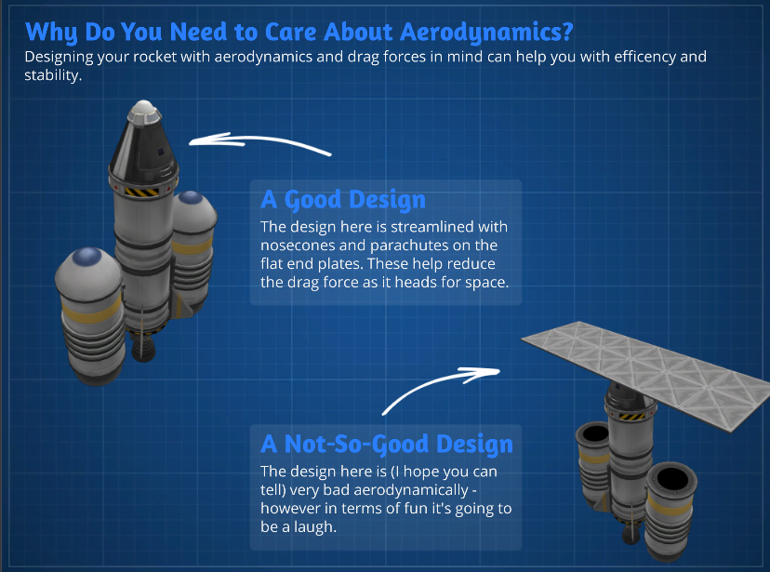

Slide 5
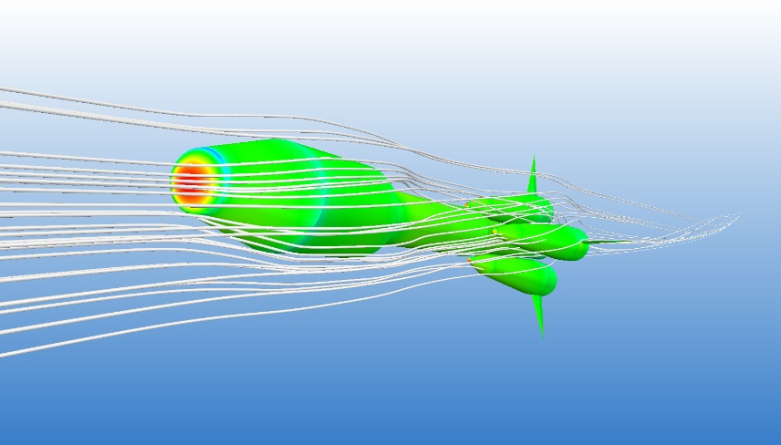
Aerodynamics
Aerodynamics is the way air moves around things. The rules of aerodynamics explain how an airplane is able to fly. Anything that moves through air reacts to aerodynamics. A rocket blasting off the launch pad and a kite in the sky react to aerodynamics. Aerodynamics even acts on cars, since air flows around cars.

Slide 6
Rocket Design/Costs
A few lessons ago you looked at materials in a rocket and forces
You now need to annotate a design with materials you would use where and why
Create a shopping list worksheet - costs of parts (seen in Kerbal)

Slide 7
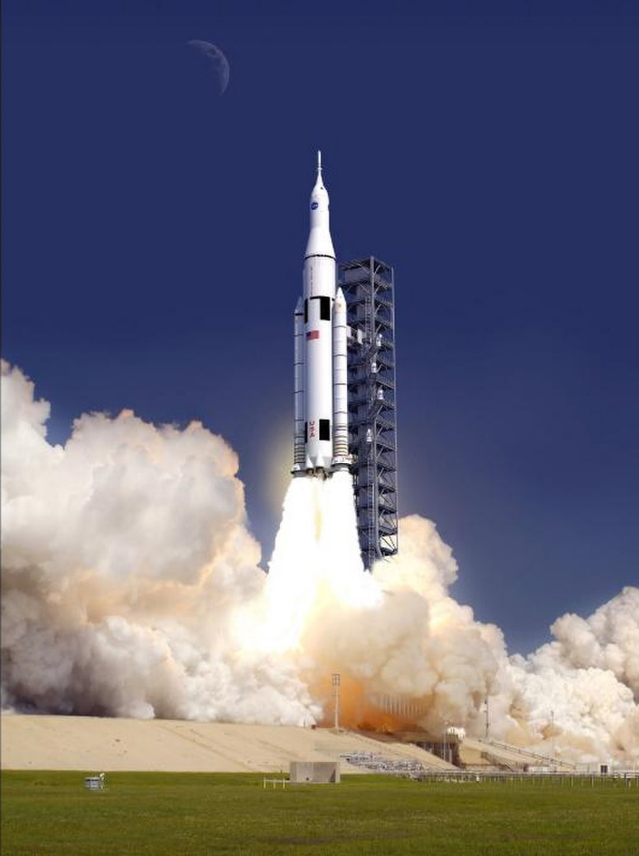
Plenary
The giant rocket NASA is building to carry astronauts to Mars and other destinations in deep space may cost $500 million per launch when it's flying regularly, space agency officials said Tuesday (Sept. 11).
Is this worth it?

