Slide 1
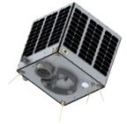
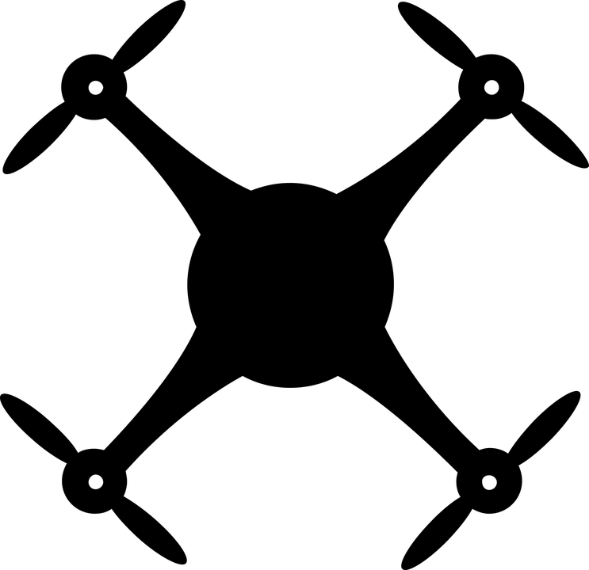
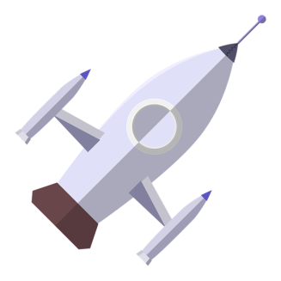
Learning Objectives
To consider how design can affect the flight
To understand how forces affect a paper aeroplane
To test and gather data from a flight effectively
Open Systems and Advanced Manufacturing Technologies

Slide 2
Starter
You all have a piece of paper
You have 2 minutes to make a paper aeroplane
We will all then stand at one end and throw them to see how far they go

Slide 3
Starter outcomes
What was different between all your aeroplanes?
What as similar?
What impacted on the distance they travelled?
What could be done different?

Slide 4
Paper Aeroplanes
You will be in groups of 2/3
Select a design (all different)
Create the aeroplane
Use the table to document the test flights
You will need to measure the distance travelled and document the flight details
Extension – now choose another design and create and test this aeroplane and complete a comparison of the two; outlining the design that was better and why.

Slide 5
Right click on chart and select ‘edit data’ to add the distances and see which designs went the furthest

Slide 6
Plenary
Which design went the furthest?
What have you learnt from this task?

