Slide 1
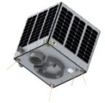
Learning Objectives
To test different rockets
To experiment with different parts
To launch and control a selection of rockets
Open Systems and Advanced Manufacturing Technologies

Slide 2
Homework – 3 laws
https://www.youtube.com/watch?v=KvPF0cQUW7s&feature=youtu.be

Slide 3
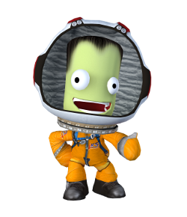
KERBAL Missions
You are going to follow the missions built into Kerbal:
How to build different rockets,
How to control different rockets
How to adjust and edit a rocket
To look at and work out what went wrong with different controls and launches
To start to think about the parts they may use and the type of rocket they will use.
Start to make notes on the rockets that worked
Complete mission logs for each mission completed
Can be completed individually or in pairs to help understanding and discussion
Worksheet on navball symbols available to be completed

Slide 4
What is the mission?
Did you succeed?
Which of these did you use? (tick or highlight achieved)
What went well?
What have you learnt?
What concepts were used?
You have a worksheet to complete with each mission
Work in groups of 2 or individually to complete a mission

Slide 5
Which missions have you completed?
What went well?
What went wrong?
What have you learnt?

