Slide 1
Malpractice and maladministration
An overview

Slide 2
Prevention
Spotting
Investigating
Tackling
Learning

Slide 3
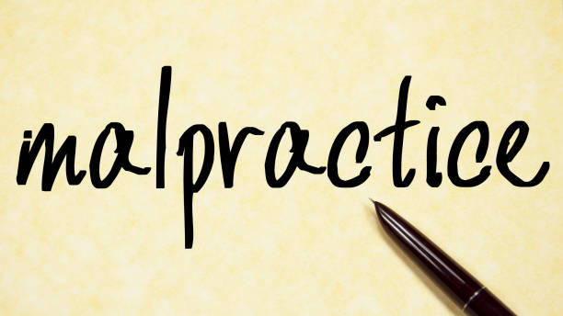
Malpractice
Malpractice is defined as any deliberate activity, neglect, default or other practice that compromises the integrity of the assessment process, undermines public confidence in TLM qualifications, and/or impacts the validity of assessment outcomes.
Malpractice may include a range of issues from the failure to implement approval criteria, to the deliberate falsification of records in order to claim certificates.

Slide 4
Malpractice examples
Two of the clearest examples of malpractice are:
cheating, or facilitating cheating, in an assessment; and
attempting intentionally to manipulate a result so that it does not reflect the Learner’s actual performance in an assessment.

Slide 5
Maladministration
Maladministration is defined as any activity, neglect, default or other practice that results in TLM, the TLM Approved Centre or Learner not complying with the specified requirements for the delivery of TLM qualifications.
Maladministration is typically, unintentional and therefore is less likely to feature any deliberate activity that looked to cause harm or compromise the integrity of the assessment process.

Slide 6
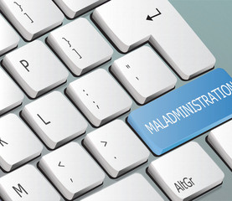
Maladministration examples
Some examples of maladministration:
avoidable delay;
mistakes arising from inattention;
faulty procedures;
failure to follow correct procedures;
poor record keeping;
inadvertent failure to take action;
poor communication; and
inadvertently giving misleading or inadequate information

Slide 7
Adverse Effect
An Adverse Effect is defined by the qualifications regulators as any act, omission, event, incident or circumstance that introduces prejudices to learners or adversely affects;
The ability of the awarding body to undertake the development, delivery or award of qualifications in a way that complies with its Conditions of Recognition;
The standards of qualifications which the awarding body makes available or proposes to make available; or
Public confidence in qualifications.

Slide 8
Policy
Approved Centres must have their own malpractice/ maladministration policy, the implementation of which may be audited at Centre monitoring visits and confirmation sought at training workshops. Guidance on the policy is included in the Centre Handbook.

Slide 9
How TLM spots malpractice/ maladministration
TLM recruits, inducts and trains our staff, contractors, Centres and associates so that individuals involved in the development, delivery and award of our qualifications, are aware of malpractice/maladministration risks, and the effects.

Slide 10
Remote arrangemnets
Remote invigilation
Remote invigilation can be one or both of live supervision or after-the-fact supervision of a learner completing the required assessment tasks.
The invigilator is in a different location to the learner.
It ensures that the learner completes the assessment under the required conditions so that the awarding organisation can assure itself of the validity of the assessment and secure the award of the qualification.
The invigilator is not assessing the learner.

Slide 11
Remote working and authenticity
Learners can be asked to show the room in which they are taking the assessment beforehand.
And they can be asked to hold photo ID in a specific space so that a photo of the learner with their ID can be taken and stored.
Use of multiple cameras has also enabled awarding organisations to prevent learners being helped by third parties.
Invigilators who are well trained in identifying any irregularities in real time.

Slide 12
Process for tackling malpractice/ maladministration
Allegations of malpractice and/or maladministration must be raised directly with TLM’s Responsible Officer who will not disclose, and will seek to protect, the identity of any whistle blower.
As much detail as possible should be submitted along with any available supporting evidence, i.e.:
Date(s) and time(s) of incident(s)
Person(s) involved
Nature of incident(s)
Findings of any Centre investigation
TLM will make an initial response/ acknowledgement in writing within 10 working days.

Slide 13
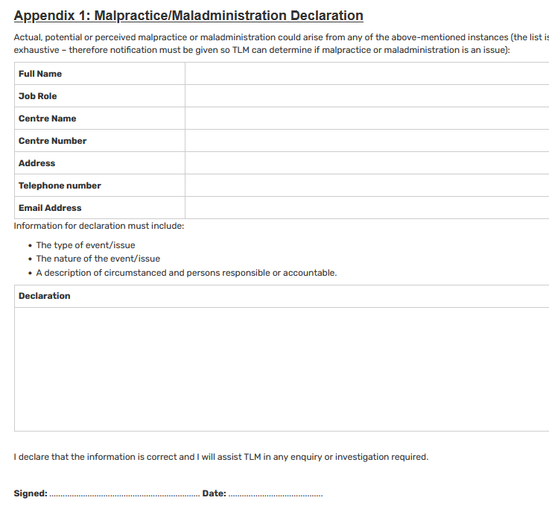
Declaration

Slide 14
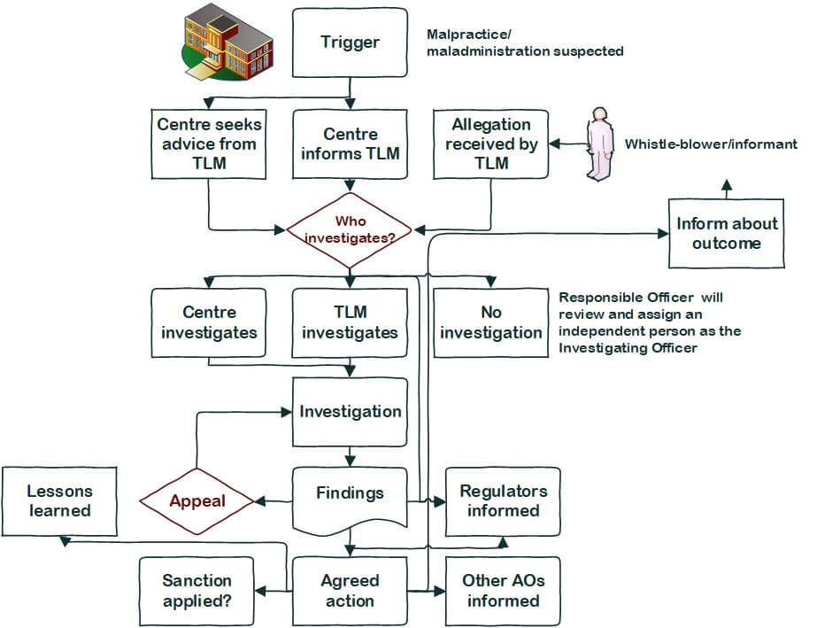
Process for tackling malpractice/ maladministration

Slide 15
How TLM acts after investigating malpractice/maladministration
Following the investigation, a draft report will be produced that the parties involved will be invited to check for factual accuracy and comment upon.
Upon receipt of the final version of the report an appeal may be made regarding actions imposed. Details of how to appeal are included in the TLM Appeals Policy.

Slide 16
Actions taken after investigation
Actions will be proportionate to the gravity and scope of the occurrence and may include the following:
The development and implementation of action plans to prevent re-occurrence;
Suspending or removing registration for units/qualifications;
Suspending or removing approval;
Imposing other sanctions as appropriate.

Slide 17
Questions and contact details
4D-4E Gagarin
Lichfield Road
Tamworth
Staffordshire
B79 7GN
United Kingdom
Telephone: +44 (0)1827 305940
TLM | The Learning Machine
e-mail: helpdesk@theingots.org

