Slide 1
What makes for safe awarding?
An overview

Slide 2
Prevention
Spotting
Investigating
Tackling
Learning

Slide 3
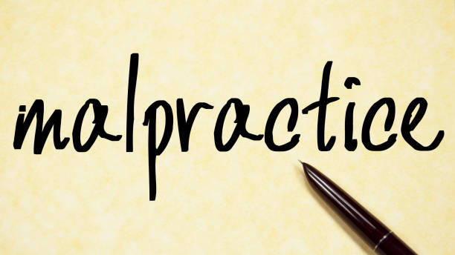
Malpractice
Malpractice is defined as any deliberate activity, neglect, default or other practice that compromises the integrity of the assessment process, undermines public confidence in TLM qualifications, and/or impacts the validity of assessment outcomes.
Malpractice may include a range of issues from the failure to implement approval criteria, to the deliberate falsification of records in order to claim certificates.

Slide 4
Malpractice examples
Two of the clearest examples of malpractice are:
cheating, or facilitating cheating, in an assessment; and
attempting intentionally to manipulate a result so that it does not reflect the Learner’s actual performance in an assessment.

Slide 5
Things that can go wrong
Work is not Learner’s own – plagiarism
Copying from internet sources
Copying between Learners
Artificial intelligence
Cheating – invigilated assessments

Slide 6
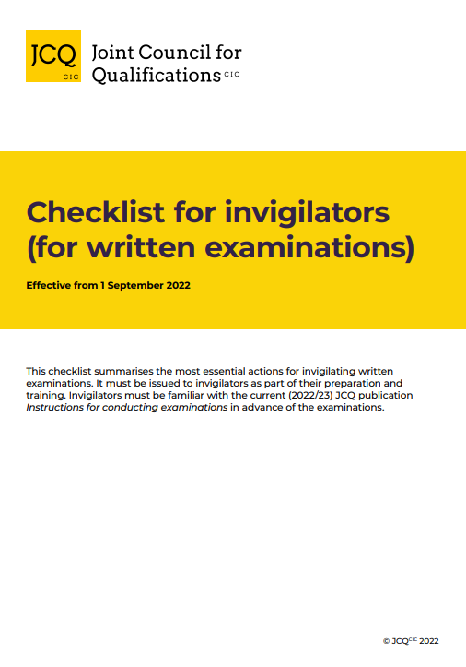
Invigilation

Slide 7
Remote arrangements
Remote invigilation
Remote invigilation can be one or both of live supervision or after-the-fact supervision of a Learner completing the required assessment tasks.
The invigilator is in a different location to the Learner.
It ensures that the Learner completes the assessment under the required conditions so that the awarding organisation can assure itself of the validity of the assessment and secure the award of the qualification.
The invigilator is not assessing the Learner.

Slide 8
Remote working and authenticity
Learners can be asked to show the room in which they are taking the assessment beforehand.
And they can be asked to hold photo ID in a specific space so that a photo of the Learner with their ID can be taken and stored.
Use of multiple cameras has also enabled awarding organisations to prevent Learners being helped by third parties.
Invigilators who are well trained in identifying any irregularities in real time.

Slide 9
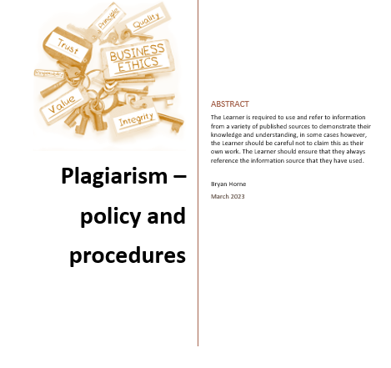
Plagiarism

Slide 10
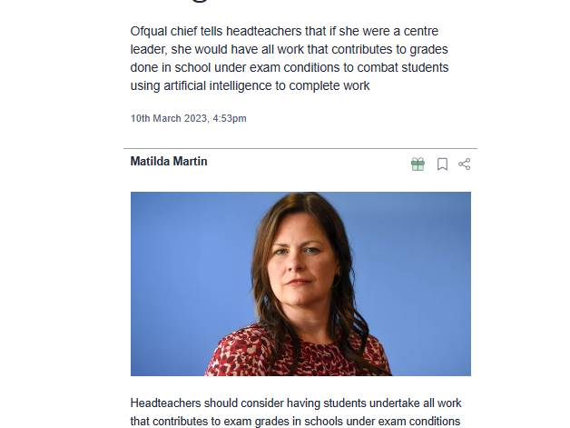

Slide 11
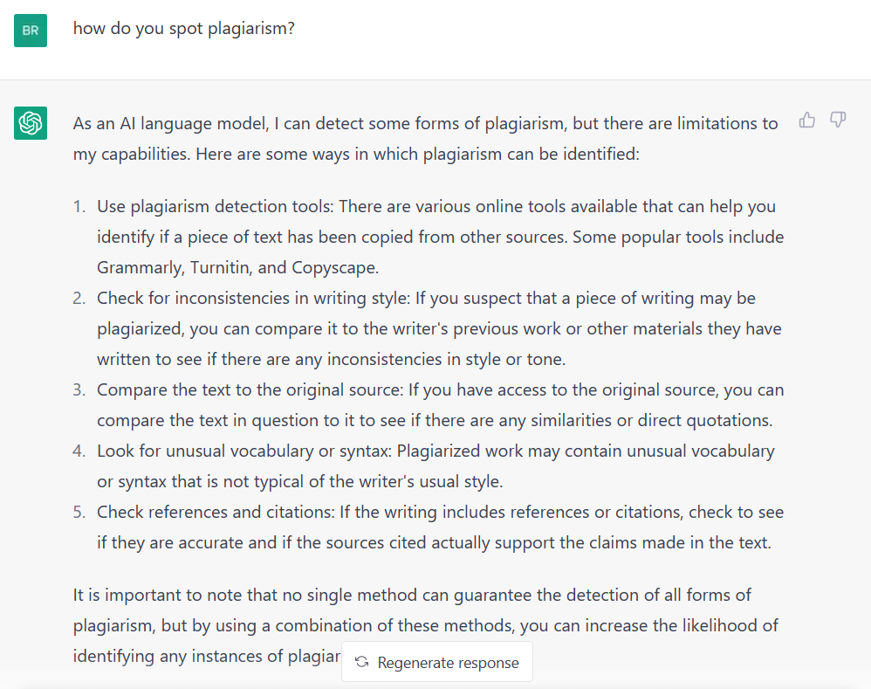

Slide 12
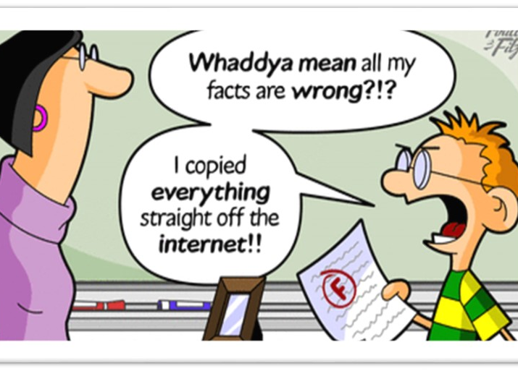
Spotting plagiarism
Unusual phrasings, noticeable unevenness of style (some very sophisticated sentences followed by some amateurish ones)
Concepts that seem too sophisticated for the level of the class, unclear or incorrect sources listed in the bibliography
A writing style or diction choice in a particular paper that seems inconsistent with that found in other samples of the Learner’s writing — these are some of the signals that you might be reading a plagiarised piece of work

Slide 13
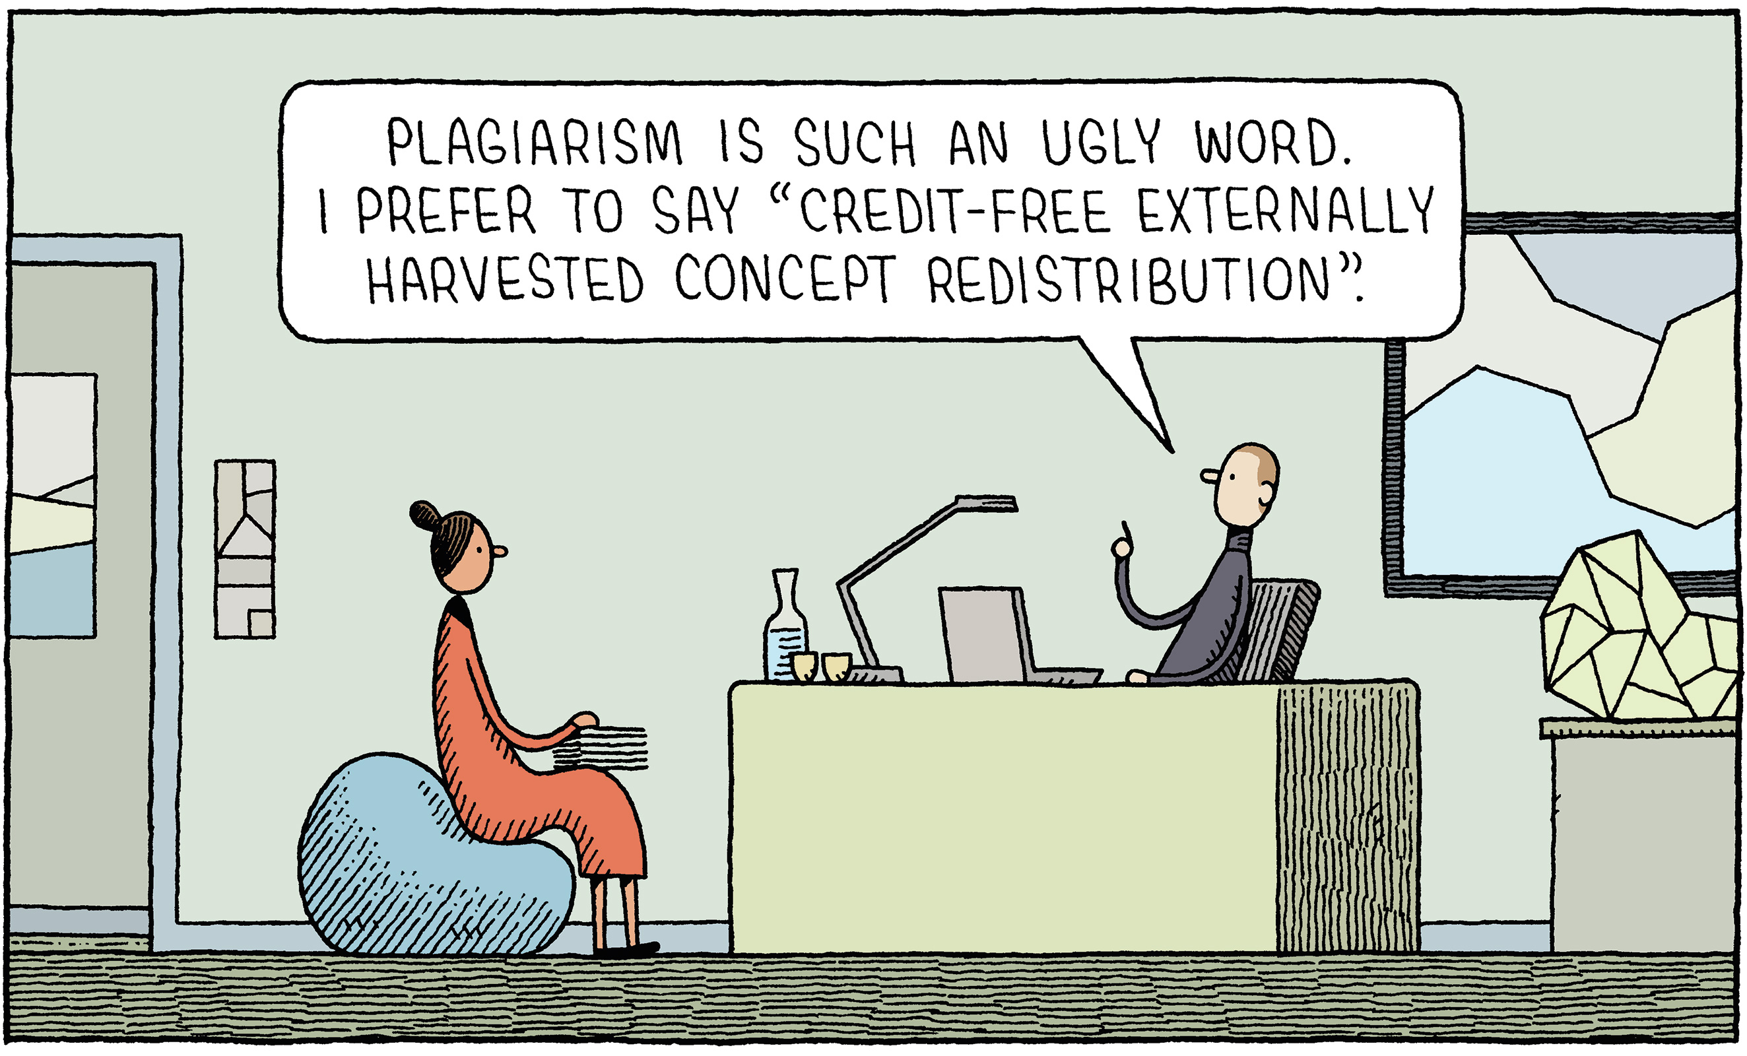
Spotting plagiarism
One technique to detect plagiarism is to enter an unusual phrase or sentence into a standard search engine (e.g., Google) and see if a match is found
A second technique is talking the work through with the Learner and discussing the content/ideas to determine the Learner’s familiarity with his/her own work and its concepts.

Slide 14
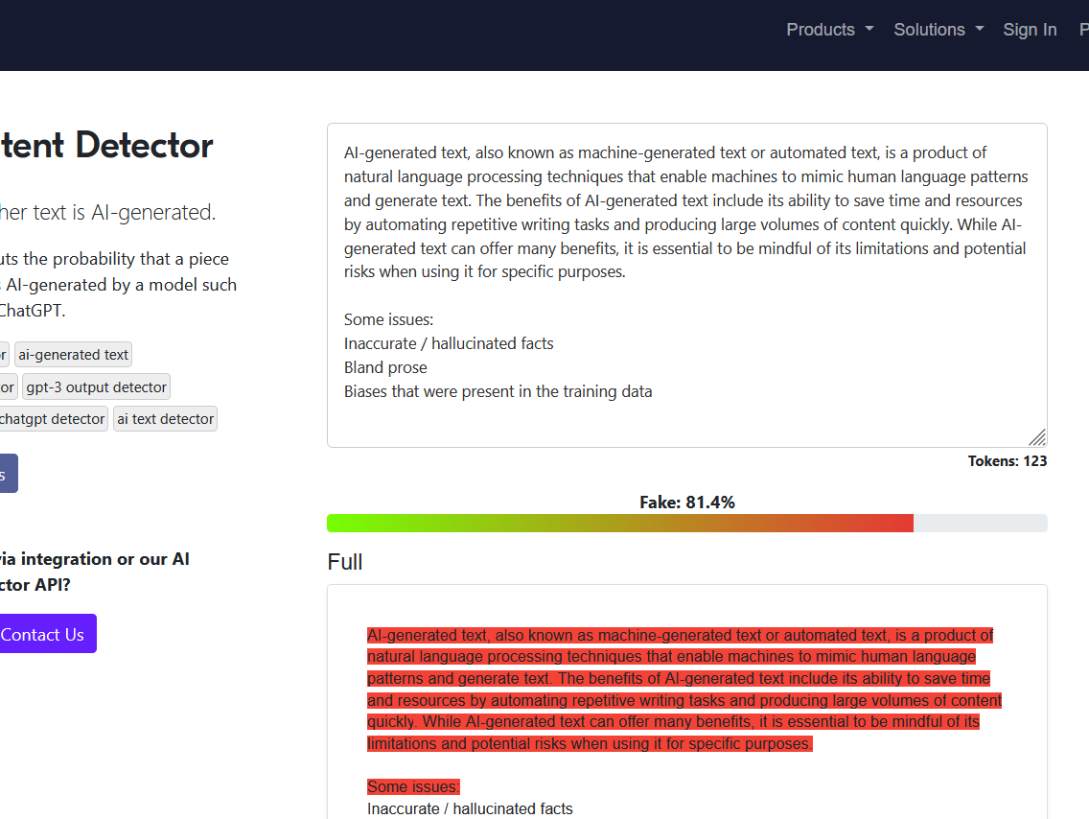
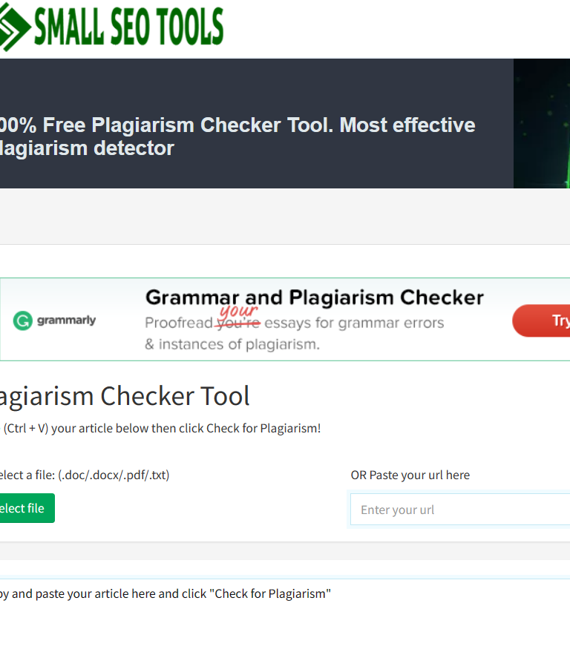
Spotting plagiarism
Free plagiarism checker - https://smallseotools.com/plagiarism-checker/
Free AI Content Detector - https://sapling.ai/ai-content-detector

Slide 15
Adverse Effect
An Adverse Effect is defined by the qualifications regulators as any act, omission, event, incident or circumstance that introduces prejudices to Learners or adversely affects;
The ability of the awarding body to undertake the development, delivery or award of qualifications in a way that complies with its Conditions of Recognition;
The standards of qualifications which the awarding body makes available or proposes to make available; or
Public confidence in qualifications.

Slide 16
Policy
Approved Centres must have their own malpractice/ maladministration policy, the implementation of which may be audited at Centre monitoring visits and confirmation sought at training workshops. Guidance on the policy is included in the Centre Handbook.

Slide 17
How TLM spots malpractice/ maladministration
TLM recruits, inducts and trains our staff, contractors, Centres and associates so that individuals involved in the development, delivery and award of our qualifications, are aware of malpractice/maladministration risks, and the effects.

Slide 18
Process for tackling malpractice/ maladministration
Allegations of malpractice and/or maladministration must be raised directly with TLM’s Responsible Officer who will not disclose, and will seek to protect, the identity of any whistle blower.
As much detail as possible should be submitted along with any available supporting evidence, i.e.:
Date(s) and time(s) of incident(s)
Person(s) involved
Nature of incident(s)
Findings of any Centre investigation
TLM will make an initial response/ acknowledgement in writing within 10 working days.

Slide 19
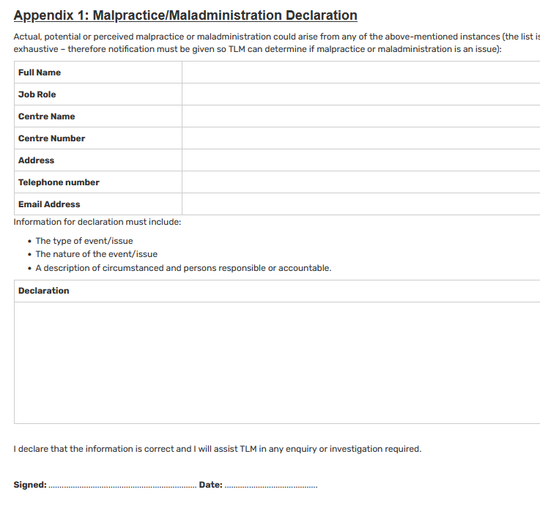
Declaration

Slide 20
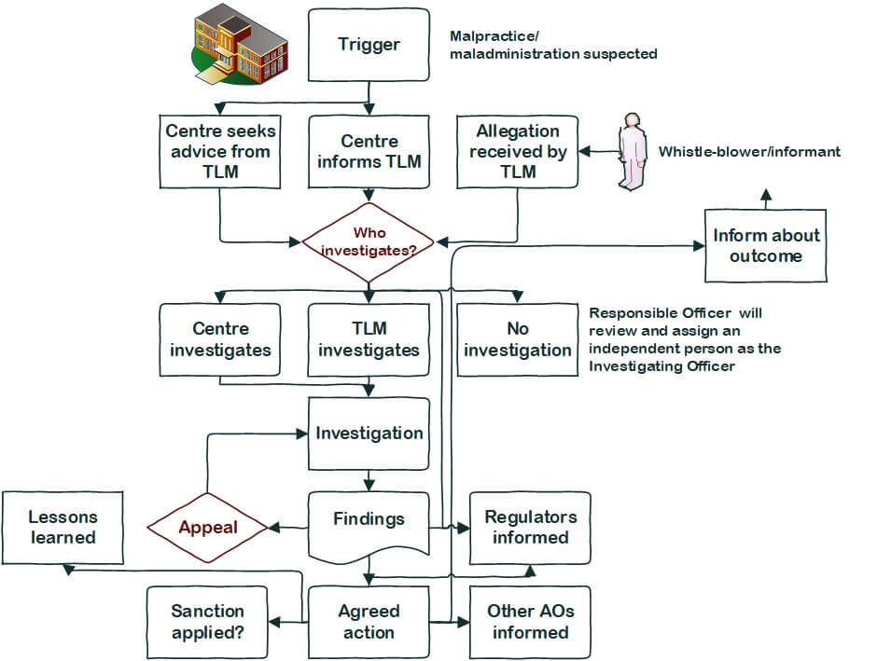
Process for tackling malpractice/ maladministration

Slide 21
How TLM acts after investigating malpractice/maladministration
Following the investigation, a draft report will be produced that the parties involved will be invited to check for factual accuracy and comment upon.
Upon receipt of the final version of the report an appeal may be made regarding actions imposed. Details of how to appeal are included in the TLM Appeals Policy.

Slide 22
Actions taken after investigation
Actions will be proportionate to the gravity and scope of the occurrence and may include the following:
The development and implementation of action plans to prevent re-occurrence;
Suspending or removing registration for units/qualifications;
Suspending or removing approval;
Imposing other sanctions as appropriate.

Slide 23
Questions and contact details
4D-4E Gagarin
Lichfield Road
Tamworth
Staffordshire
B79 7GN
United Kingdom
Telephone: +44 (0)1827 305940
TLM | The Learning Machine
e-mail: helpdesk@theingots.org

